Slide 1
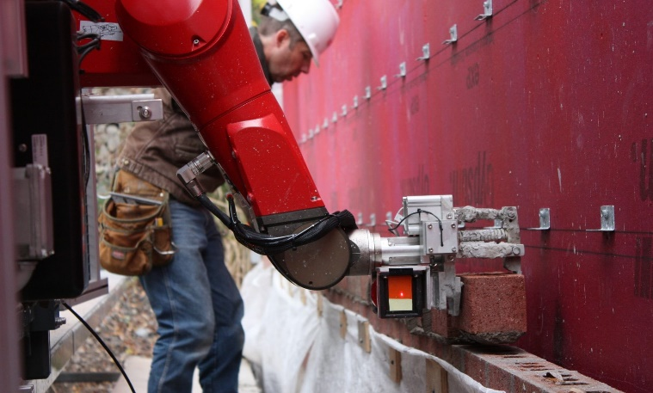
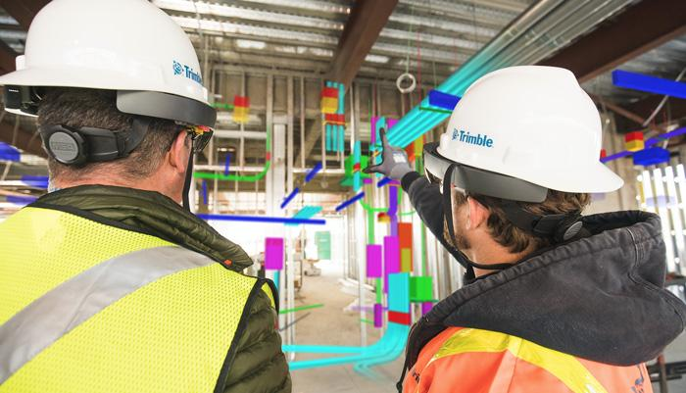
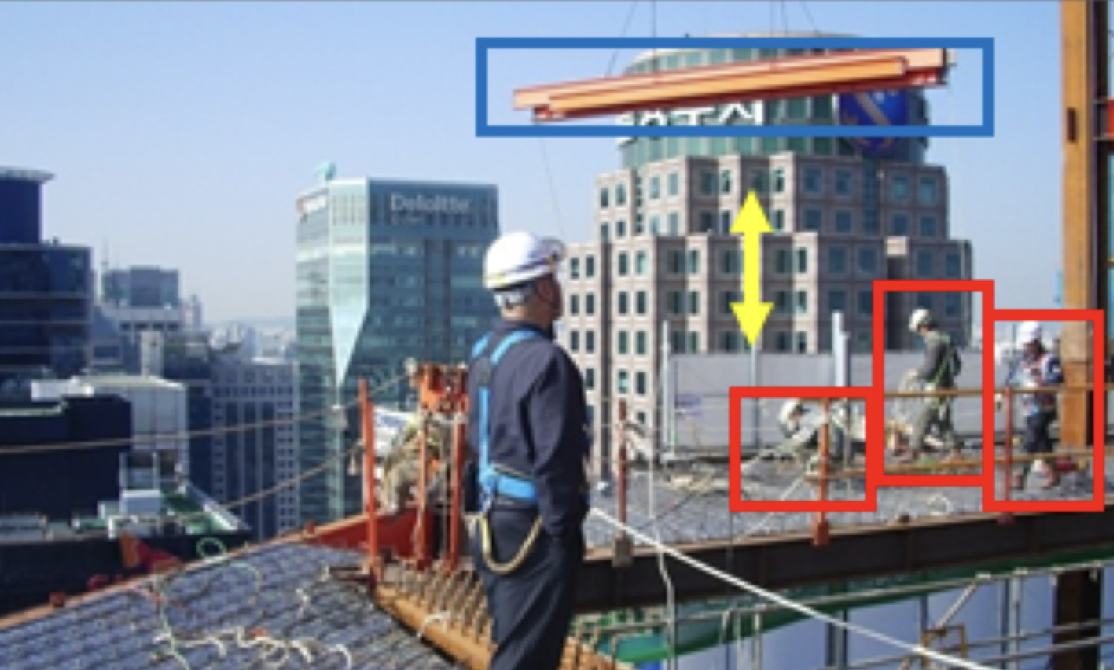
Construction Automation Technology Using Construction Robots
Development of robot autonomous driving technology applicable to the dynamic environmental changes of construction sites
Development of a worker-robot interface based on augmented reality for construction work
Digital Twin and AI-based Smart Construction Business Management Technology
Development of sensing devices for on-site environmental information and modules for generating digital twin models for site management
Automatic construction of standard image datasets for construction and Multi-Camera site monitoring
Development of a multidimensional Moral Turing Test for the ethical use of AI in construction bidding
AI-based Worker Safety Management Technology
Development of a low-cost non-verbal risk perception ability assessment system for construction workers
Development of AI technology for automatic recognition of risk factors in industrial sites based on CCTV footage

Slide 2
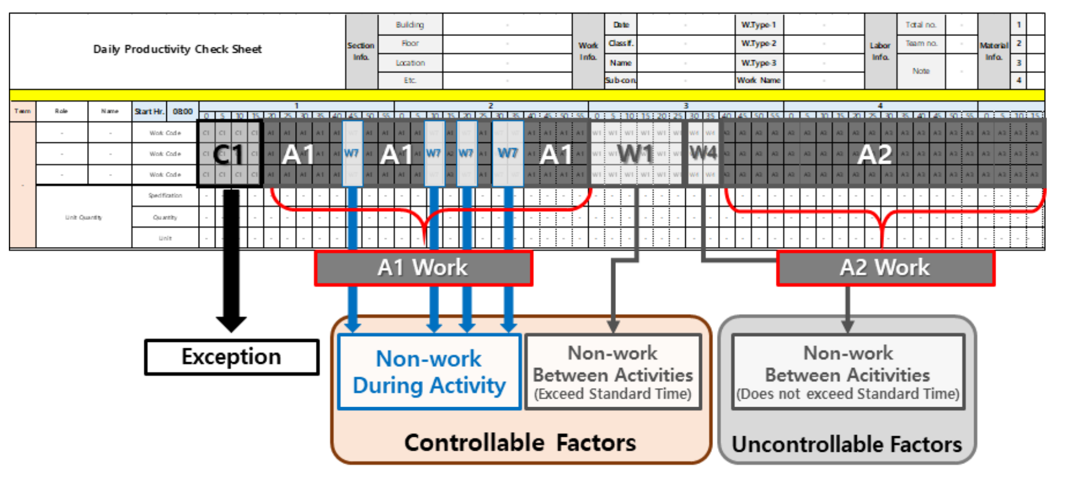
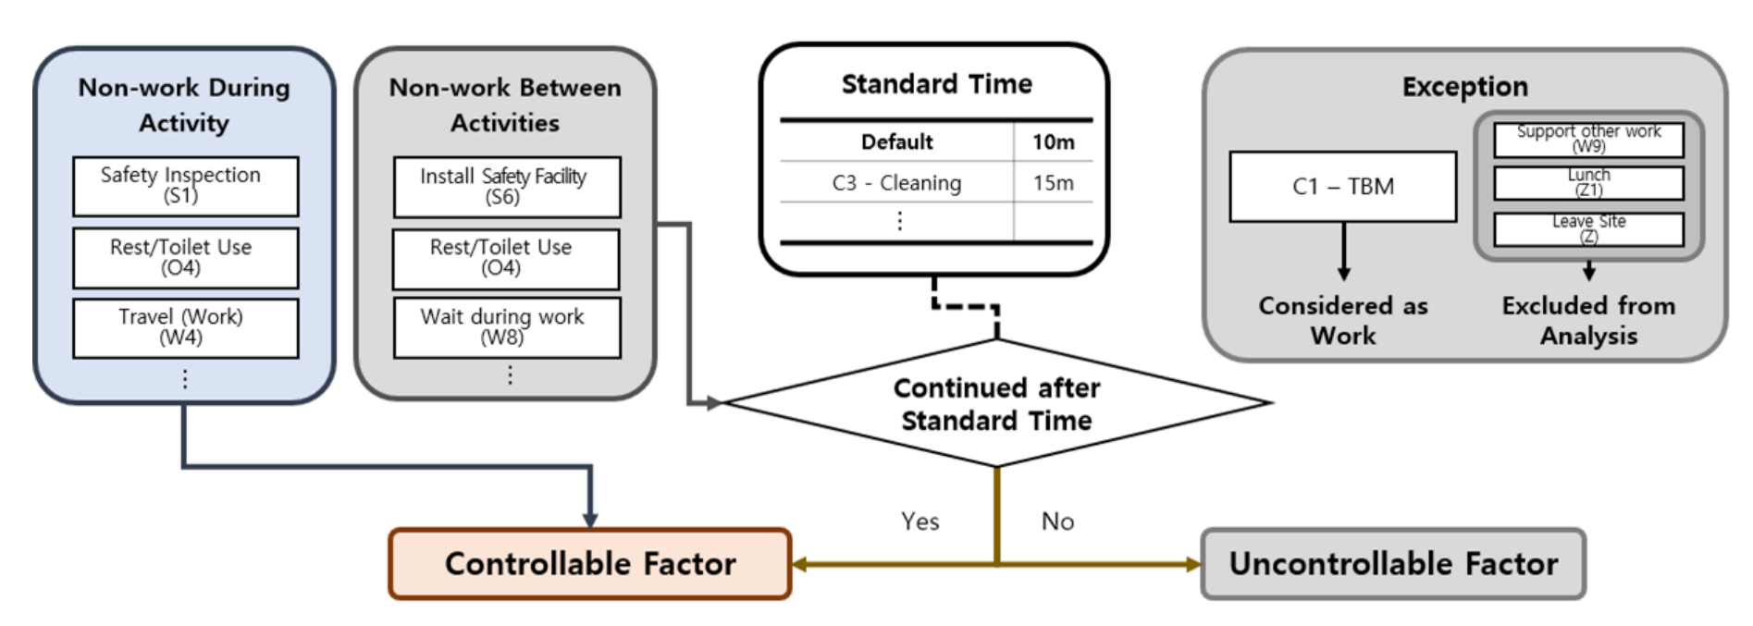
Non-work Factors Classification Process
Classification of Non-work Factors in Adv-FMR Check Sheet

Slide 3
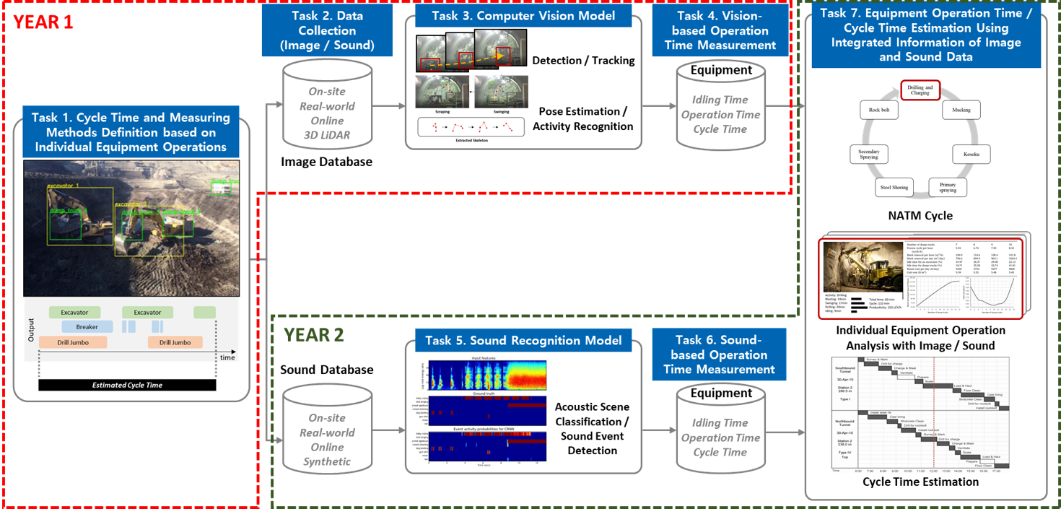
YEAR 1
Task 2. Data Collection
(Image / Sound)
Task 3. Computer Vision Model
Task 4. Vision-based Operation Time Measurement
Task 7. Equipment Operation Time / Cycle Time Estimation Using Integrated Information of Image and Sound Data
Task 1. Cycle Time and Measuring Methods Definition based on Individual Equipment Operations
YEAR 2
Task 5. Sound Recognition Model
Task 6. Sound-based Operation Time Measurement

